Slide 1

Cyber terrorism
Subject: Introduction to Cyber Security
Code:21CS653
Module:1(Cyber Crime)
Activity:1

Slide 2
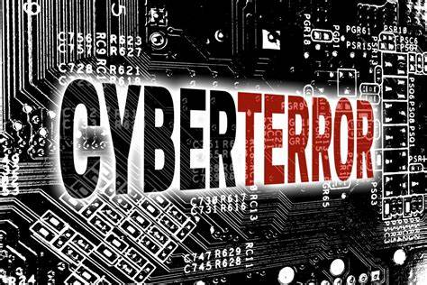
What is Cyber Terrorism:-
Cyber terrorism involves the use of the internet .
Digital technologies to carry out malicious activities (Hacking, phishing, etc..)with the intent to cause fear, disrupt systems, or harm individuals, organizations, or governments.
It typically includes attacks on computer systems, networks, or data, and can range from disrupting critical infrastructure to stealing sensitive information or propagating propaganda(Propagating propaganda means spreading information, ideas, or rumors deliberately to influence people's opinions or behaviors.) to incite violence.

Slide 3
Characteristics of Cyber Terrorism:-
Motivation:- Cyber terrorists are usually driven by ideological, political, or religious goals. Their primary aim is to cause fear, disrupt activities, or achieve propaganda objectives.
Targets:- Common targets include government systems, critical infrastructure (such as power grids, water supplies, and transportation systems), financial institutions, and private sector companies.
Methods:-
Distributed Denial of Service (DDoS) Attacks: Overwhelming systems with traffic to make them inaccessible.
Malware: Using viruses, worms, or trojans to damage or gain unauthorized access to systems .
Phishing: Deceptive attempts to obtain sensitive information by masquerading as a trustworthy entity.
Ransomware: Encrypting a victim's data and demanding a ransom for the decryption key.
Hacking: Unauthorized access to computer systems to steal, alter, or destroy data.

Slide 4
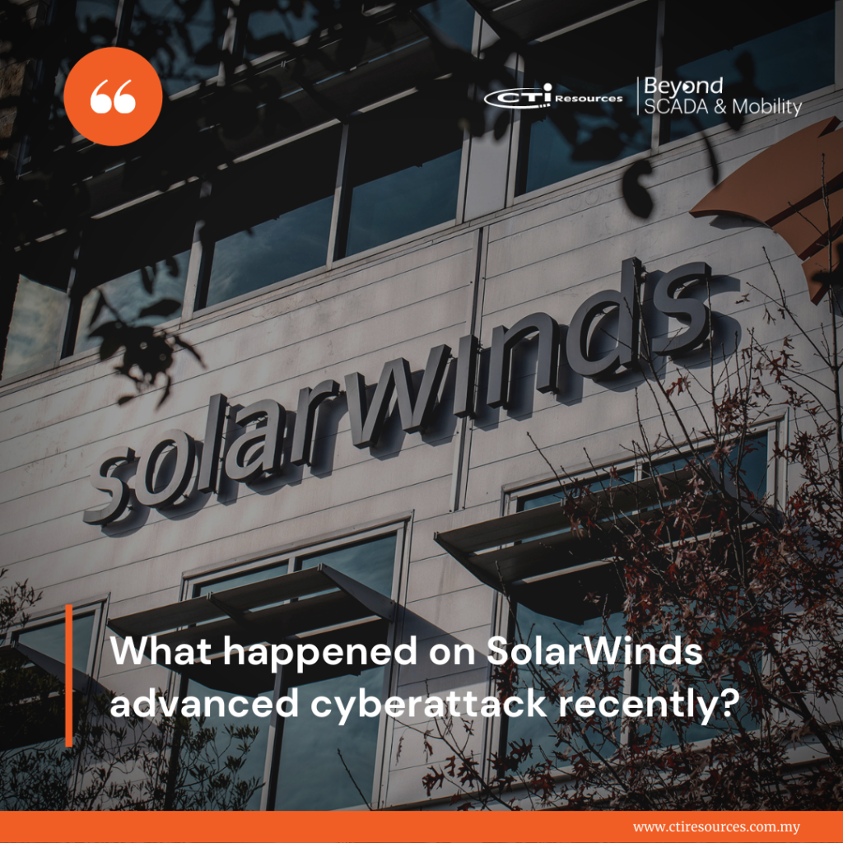
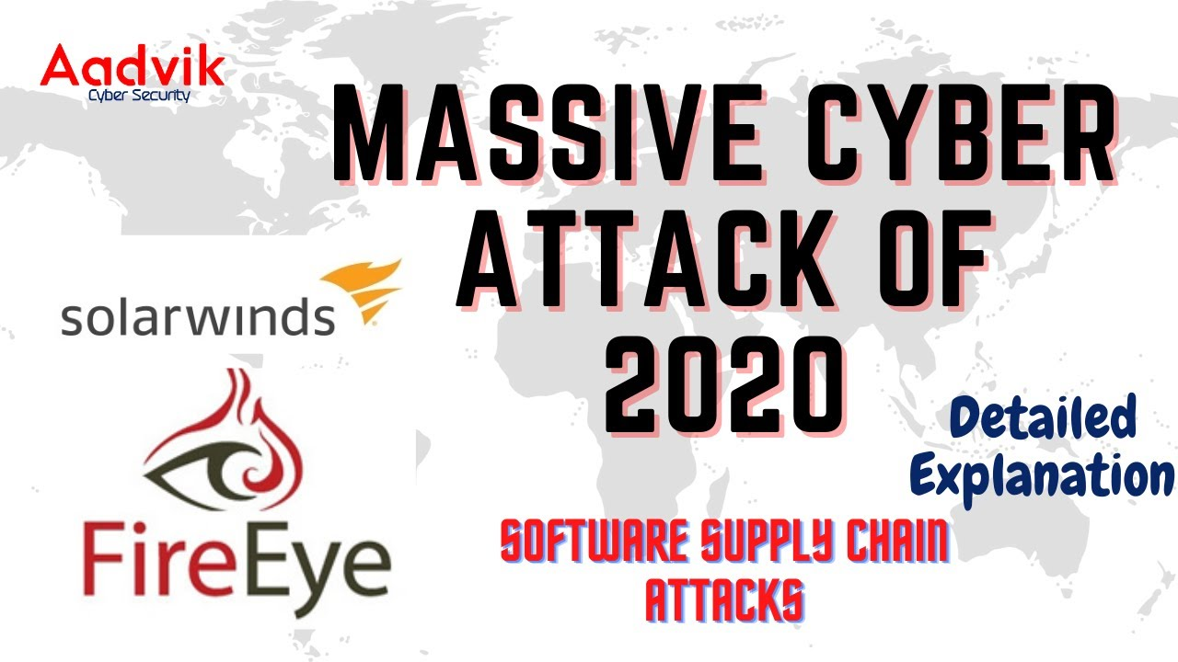
Real time example:- The 2020 Solar Winds Cyber Attack
Incident Over View
Date:-Discovered in December 2020

Slide 5
The 2020 Solar Winds Cyber Attack:-
Date:- Discovered in December 2020
Target:- Numerous organizations, including U.S. government agencies, private sector companies, and critical infrastructure entities
Impact:- Compromise of a widely-used IT management software, leading to potential access to sensitive data and systems across many sectors

Slide 6
Details:-
Background:
SolarWinds Software: SolarWinds provides IT management software used by thousands of organizations globally. The attack targeted the Orion software platform, which is used for network monitoring and management.
Attack Duration: The malicious code was inserted into the Orion software updates distributed between March and June 20
Attack Vector:
Supply Chain Attack: The attackers compromised SolarWinds’ build environment, inserting malicious code into the legitimate Orion software updates. When clients installed the updates, they inadvertently introduced the malware into their networks.
SUNBURST Malware: The malware, known as SUNBURST, created a backdoor in the affected systems, allowing the attackers to remotely access and manipulate the networks.
Targeted Entities:
Government Agencies: U.S. departments of Homeland Security, Treasury, Commerce, and others were among the affected.
Private Sector: Major corporations, including technology firms, cybersecurity companies, and other critical infrastructure providers, were compromised.
Critical Infrastructure: Entities managing critical infrastructure, including utilities and communication providers, were also targeted. 20, making the breach undetected for several months.

Slide 7
Details:-
Effects:
Data Breach: Sensitive information, including emails and proprietary data, was potentially accessed by the attackers.
Operational Impact: The attack led to significant operational disruptions as organizations scrambled to identify and mitigate the breach.
Long-Term Security Risks: The deep access gained by the attackers posed ongoing security risks, requiring extensive investigations and security enhancements.
Response and Mitigation:
Incident Response: Organizations affected by the breach initiated incident response protocols, working to isolate and remove the malicious code from their systems.
Government Action: The U.S. government launched investigations into the breach, involving cybersecurity agencies and law enforcement.
Patch and Update: SolarWinds issued updates to fix the compromised software, and affected organizations were urged to apply these patches promptly .
Enhanced Security Measures: Both SolarWinds and its clients implemented enhanced security measures to prevent future supply chain attacks, including more rigorous code audits and improved monitoring of software builds.

Slide 8
Details:-
Key Lessons and Preventive Measures Supply
Chain Security: Highlighted the critical need for robust supply chain security measures, including thorough vetting of third-party software and regular security audits.
Advanced Threat Detection: Emphasized the importance of advanced threat detection and response capabilities to identify and mitigate sophisticated cyber threats.
Multi-Layered Security: Underlined the necessity of implementing multi-layered security defenses, including network segmentation, endpoint protection, and strict access controls.
Collaboration and Information Sharing: Showcased the value of collaboration and information sharing among government agencies, private sector entities, and international partners in addressing cyber threats .
Incident Response Planning: Reinforced the importance of having comprehensive incident response plans in place, ensuring quick and effective actions in the event of a cyber breach.

Slide 9
Conclusion:-
The 2020 SolarWinds cyberattack is a significant example of cyber terrorism, demonstrating the vulnerability of supply chains and the extensive reach of state-sponsored cyber espionage activities. The incident underscored the importance of robust cybersecurity practices, enhanced threat detection capabilities, and international cooperation in defending against and responding to sophisticated cyber threats.

Slide 10


